Slide 1
Parsing Indian English News Headlines
Samapika Roy
Department of Humanistic Studies
Indian Institute of Technology (BHU), Varanasi, India
Under the Supervision
Of
Dr. Sukhada
Anil Kumar Singh

Slide 2
Background & Motivation: Rationale
Headlines compress grammar to deliver maximum meaning with minimal words.
Linguistic parsers, trained on full canonical English, may misinterpret them
Limited research exists on parsing such non-canonical or reduced registers.
Quantitative comparison between the canonical register and the reduced register
Notes:
This research sits at the intersection of syntax and computation.
Headlines form a unique register — compact, elliptical, yet grammatically structured.
Such forms challenge conventional parsers that rely on full sentence grammar.
Although the study began with Indian English data, we realized the reduction phenomenon transcends variety.
This gap — between how reduced syntax works linguistically and how parsers handle it — defines the rationale for my study.

Slide 3
Background & Motivation: Context
Examines the syntactic and computational structure of news headlines.
Treats headlines to be in the reduced register marked by reduction and creativity
Understanding reduced syntax relevant for linguistic theory and NLP
Term Indian English used to refrain from generalized claims
However, it might potentially be generalizable
Notes:
This research sits at the intersection of syntax and computation.
Headlines form a unique register — compact, elliptical, yet grammatically structured.
Such forms challenge conventional parsers that rely on full sentence grammar.
Although the study began with Indian English data, we realized the reduction phenomenon transcends variety.
This gap — between how reduced syntax works linguistically and how parsers handle it — defines the rationale for my study.

Slide 4
Research Aims
To understand and analyze the the syntax of news headline
How it differs from the full sentence canonical register
Developing feature-value computational representation for NHs
Notes:
Page 3 outlines the main research aim: to construct a framework that can linguistically and computationally interpret reduced syntax in Indian English headlines. It combines linguistic description with parser-based modeling.

Slide 5
Research Objectives
Identify structural and morpho-syntactic features of reduced syntax
Compare reduced structures with their canonical equivalents.
Formulate a category-based description of these contrasts
Develop a feature–value schema to encode them formally
Using computational schema to quantitatively analyze the differences
Between the two registers
Notes:
Page 3 outlines the main research aim: to construct a framework that can linguistically and computationally interpret reduced syntax in Indian English headlines. It combines linguistic description with parser-based modeling.

Slide 6
Research Questions
What are the morphosyntactic characteristics of news headlines
Reduced register
How do existing parsers interpret such reduced syntactic forms
How can reduced syntax be represented computationally
To understand the register differences
To possibly improve parser performance
Notes:
The aim here is focused and formal: to represent syntactic reduction in a way that can be both linguistically interpretable and computationally processable.
The objectives trace a deliberate path — from description, to categorization, to formalization, and finally to computational testing.

Slide 7
Scope and Limitations
Focus on English (Indian) headlines published in national newspapers
Excludes other reduced registers: Slides with bullet points (this one!)
Non-standard (reduced) registers: Social media, microblogging
Restricted to morphosyntactic features
Qualitative and quantitative comparative analysis

Slide 8
Benefits of the Research
The language resources may be used for register comparisons
Preparation of parallel data of registers
Extracting morphosyntactic information from such data
Correct labeling of grammatical categories of reduced registers
Designing representations of morphosyntactic difference between registers
For better Information Retrieval systems for non-canonical registers
Machine Translation and other NLP applications

Slide 9
Structure of the Thesis
Chapter 1: Introduction
Chapter 2: Literature Review
Chapter 3: Data Collection, Cleaning, and Analysis
Chapter 4: Reduced Register as Used in NHs: Observations
Chapter 5: Reduced-Canonical Registers: Computational Representation
Chapter 6: Canonical-Reduced Registers: Findings and Concluding Comments

Slide 10
Research Road Map
Data collection and cleaning
Parsing and error analysis
Linguistic analysis
Transformation guidelines
Computational feature-value representation creation
Comparison of registers in terms of the created representation

Slide 11
Previous Works on News Headlines
Linguistic Manipulation: An Analysis of How Attitudes are Displayed in News Reporting (Nordlund, 2003)
Linguistic Analysis of Newspaper Discourse in Theory and Practice (Pajunen,2008)
A Linguistic-Stylistic Analysis of Newspaper Reportage (Agu, 2015)
Tense in News Headlines (Hameed, 2008)
The uses of the present tense in headlines (Chovanec, 2008)
Of headlines & headlinese: Towards distinctive linguistic and pragmatic genericity (Isani, 2011)
A Brief Study on the Language of Newspaper Headlines Used in “The New Light of Myanmar” (Moe, 2014)

Slide 12
Previous Work on News Headlines:
Automatic extraction of news values from headline text (Alicja Piotrkowicz et al.,2017)
Emotion classification of news headlines using svm (Kirange and Deshmukh, 2012)
Generating headline summary from a document set (Sarkar and Bandyopadhyay, 2005)
Analysis of the Relation Between Stock Price Returns and Headline News Using Text Categorization.(Takahashi, 2007)
Headline Evaluation Experiment Results (Zajic, 2004)
Event-driven Headline Generation (Rui Sun et al., 2015)
Headline Generation based on Statistical Translation (Banko et al., 2000)
Using Thematic Information in Statistical Headline Generation (Wan, et al., 2003)

Slide 13
Research Gap
Lack of linguistic characterization of English (Indian) NHs
Study of parsers for reduced register structures and text
Absence of formal, category-based mapping
Between canonical and reduced registers
No feature–value schema capturing structural reduction
Absence of syntactico-semantic model that integrates:
Linguistic and computational perspectives

Slide 14
Contributions
NHs corpus: A corpus of ~20,000 headlines of English (Indian) NHs collected
Linguistic analysis of the NHs data
Study of different structures of NHs and words compositions
Guideline creation for transformation of reduced structures of NHs
Categorical and feature-value representation for differences
Qualitative and quantitative comparison of registers

Slide 15
Methodology Overview
Corpus-based study on reduced structures of news headlines
Focus on syntactic reduction, structural analysis
Analytical framework combining linguistic and computational methods

Slide 16
Data Collection and Cleaning
Collection:
From online newspapers: The Hindu, Hindustan Times, and Times of India
Manual and automated scraping; filtered for relevance and completeness
Corpus size: ~20,000 NHs with more than 3 lakh word tokens
Cleaning:
Multiple repetition of the same text- e.g., the word ‘section’, headlines
Unwanted text: e.g., names of places

Slide 17
Parser Output and Error Analysis
Parsing with existing parsers : e.g. Stanford Parser
Compared with grammatical structures of a language to analyse the errors
Ex. NH: Boat capsize toll touches 21
Constituency parse output:
(ROOT
(NP
(NP (NNP Boat))
(NP (JJ capsize) (NN toll) (NNS touches))
(NP (CD 21))))

Slide 18
Parsing Output and Error Analysis
Noun tagged as adverbs:
Headline: Men cook up an experience to nibble at
(ROOT (S
(VP (ADVP (RB Men)) (VB cook) (PRT (RP up))
(NP (DT an) (NN experience))
(S
(VP (TO to) (VP (VB nibble) (PP (IN at))))))))

Slide 19
Parsing Output and Error Analysis
Verbs marked as adjectives:
Headline: Boat capsize toll touches 21
Output:
(ROOT (NP (NP (NNP Boat))
(NP (JJ capsize)
(NN toll) (NNS touches))
(NP (CD 21))))

Slide 20
Common Parsing Errors Observed
POS misclassification:
Proper nouns as verbs: Delhi rains floods roads
Omitted determiners and auxiliaries confuse parser expectations
Wrong attachment in phrases due to compact syntax
Coordination ambiguity and subject drop issues

Slide 21
Linguistic Analysis
Corpus details: Top 3 English newspapers in India
Audit Bureau of Circulations, compiled by Media Research Users Council (MRUC)
Indian Readership Survey (IRS) 2017
Domain: General
Newspapers | The Hindu (TH) | Times of India (TOI) | Hindustan Times (HT)
Corpus (2016-17) | 1,000 | 1,000 | 1,000
Corpus (2019-20) | 1,000 | 1,000 | 1,000

Slide 22
Linguistic Analysis Dimensions
Morphological analysis: compounding, clipping, and nominalization
Syntactic analysis: ellipsis, omission, inversion
Semantic analysis: idiomatic usage, wordplay, and cultural terms
Register focus: reduced syntax as an adaptive strategy

Slide 23
Linguistic Analysis of Reduced Structures
Declarative Headlines
Statements that relay information, adhere to basic SOV
Examples:
TH: Medical services in Mysuru likely to be hit today
HT: China isolated on Jammu and Kashmir in informal UNSC talks
TOI: Kuldeep Singh Rathore named as chief of Himachal Congress

Slide 24
Linguistic Analysis of Reduced Structures
Interrogative:
Type 1: Simple Interrogatives:
Examples:
TH- Doctors' protest: Will govt. give in on contentious provisions of KPME Bill?
HT: Will Maharashtra Rera’s SRO filter benefit homebuyers eventually?
TOI: What happens to Rishabh Pant now?
Type 2: Echo questions: Statements, do not involve WH-movement
Examples:
TH: Ranbir Kapoor plays a DJ in Brahmastra? An insider spills the beans
HT- Spielberg’s stand cost Michael Douglas Cannes Glory?
TOI- Maharashtra to bail out 11,000 staffers with fake caste certificates?

Slide 25
Linguistic Analysis of Reduced Structures
Imperative:
Examples:
Develop scientific temper
Focus on environment
Exclamative:
Examples:
Just for the health of it!
Catch them young!

Slide 26
Linguistic Analysis of Reduced Structures
2. Types of Tenses:
Present
Historical Present (Chovanec, 2008) | UK court clears extradition of Dawood's aide Jabir Moti to US Youth dies at police station
Present Continuous | Pinarayi protecting encroachers Rs. 330 cr. towards MNREGA wage payment pending

Slide 27
Linguistic Analysis of Reduced Structures
Past
Simple Past | Woman molested by beauty salon staffer Two killed in gaur attacks
Past Participle | 11 bitten by dogs in Kollam Sandalwood trees stolen from C.V. Raman's home

Slide 28
Linguistic Analysis of Reduced Structures
Future Time
Future (through infinitive) | State to commission survey on bonded labour Statute Bench to examine plea against M.M. Mani
Using modal verbs | First Rafale will land in India by 2019: Trappier 'Congress will play it fair'
Within a day (Glassman, 2015) | Art workshop concludes today Legislature session begins in Belagavi today

Slide 29
Linguistic Analysis of Reduced Structures
Phrasal Verbs (Garnier & Schmitt, 2015; Liu & Myers, 2018)
Phrasal Verbs Type 1: Intransitive PVs. | Men cook up an experience to nibble at 150 volunteers clean up Hampankatta area
Phrasal Verbs Type 2: Transitive PVs. | Check-dams coming up across T.N. at a cost of Rs. 1,000 cr. Siddha council takes up vitiligo cause
Phrasal Prepositional Verbs | Centre for Defence Studies to be set up at Andhra University

Slide 30
Linguistic Analysis of Reduced Structures
Word-Formation Processes:
Cliticization | Delhi's pollution levels rise again
Clipping (Apocope) | RBI relaxes 26% cap for ARCs
Abbreviation | Car stolen from Gzb man found in vacant plot
Acronym | MP Cong gen secy dies of Covid-19 after wife

Slide 31
Linguistic Analysis of Reduced Structures
Circumstantial Compounding (Morpho-Syntax: Cui et al., 2018):
Coordinative compounds:
Two constituents generally of the same syntactic category
Which bear equal semantic weights.
Tube panic: 2 wanted for questioning
City beauty floors them
Subordinate compound:
Where first constituent, is the modifier
Modifies the second constituent, which is the head
Displacement fear grips tribals
Bangladesh promises help to arson victims

Slide 32
Linguistic Analysis of Reduced Structures
Code-mixing | One 'magarmach' down: Badal after Sajjan Kumar sent to jail
Scare-Quotes | Road map to regaining 'cleanest' tag
Quotes Without Speaker | 'Aggression, violence are a reality of the world we live in today'

Slide 33
Linguistic Analysis of Reduced Structures
Punctuations
Comma | Type 1: Speech-Speaker Need an NIA unit in Mangaluru, says BSY
 | Type 2: To conjoin two incidents Amazon to create a million jobs, Goyal takes back criticism
 | Type 3: Coordinate Conjunction Anurag Sharma thanks policemen, officers
 | Type 4: Cause-effect Bhalswa landfill fires, smog have residents in chokehold

Slide 34
Linguistic Analysis of Reduced Structures
Punctuation
Colon | Type 1: Speech-speaker Recruitment policy in T.N. flawed: TVK
 | Type 2: Cause-effect Misuse of funds: Official held
 | Type 3: Topic-Information Businessman murder case: no arrests yet
 | Type 4: Topic- Description ADHD: The attention question Claridge's: The Cookbook

Slide 35
Linguistic Analysis of Reduced Structures
Punctuation:
Semi-Colon | Type 1: Incident-result relation Drunk student rams auto-rickshaws in Chennai; one person killed
 | Type 2: Two incidents 1,969 fishermen traced; search on for another 855
Ellipses | For today's engagement... Let the games begin...

Slide 36
Linguistic Analysis of Reduced Structures
Linguistic Items Dropped:
Dropping of the subject | Living up to a cinematic tradition Taking a trip down memory lane
Dropping of the verb | Charges against CJI Misra scurrilous
Conditional Dropping of Auxiliary | Church reformation celebrated Gujarat govt. is most corrupt: Rahul
Conditional Dropping of Article Same conditions for definite and indefinite articles | Man dies of injuries A blow to foes, saysEPS A celebration of Childhood

Slide 37
Linguistic Analysis of Reduced Structures
Other linguistics items observed:
Demonstratives: That, this, these, those
Quantifiers: Some, every, each
Complementizers: That, if, whether, for
Cardinal Noun Phrases- Ex. 11 bitten by dogs in Kollam

Slide 38
Linguistic Analysis of Reduced Structures
Rhetorical devices used
Personification | Facebook says technical error caused vulgar translation of Xi Jinping's name
Metaphors | It is raining groundnuts
Ambiguity | The lob is here to stay
Puns with homophones | Hiding in ‘Plane’ sight.

Slide 39
Categorical Representation
We classified them into the following broad categories:
Declarative
Historical Present
Echo Questions
Interrogative
Non-interrogative Wh
Aux Drop
NP Drop
Quotes without speakers
Punctuations
Fragments

Slide 40
Annotation: Headlines Classification
Task: Students given headlines and provided with categories
Map the headlines as per the best fitting categories
Annotators
From various backgrounds were included
Multiple headlines were given from each broad category
Annotation Agreement Result
Cohen’s kappa: Fair agreement

Slide 41
Feature-value Representation
Created a syntactico-semantic feature representation
Based on linguistic analysis on NHs corpus
Headline_Structure: Single-line or multi-line
Headline_Type: Fragment or Non-fragment
Fragment_Type: Complex compounds, phrases, or subordinate clauses
Non-Fragment_Type: Declarative, Imperative, interrogative, exclamatory

Slide 42
Structure of the Feature–Value Schema
Features derived from linguistic categories:
Morphological
Tense, aspect, number
Syntactic: Clause type, subject presence, auxiliary omission
Functional: Focus, emphasis, information load
Each headline represented as a set of feature–value pairs

Slide 43
Reduced-Canonical Registers:
Computational Representation
Represents syntactic and morphological reductions
In terms of feature–value pairs
Represent structural reduction
Through binary and categorical features
Captures information beyond surface structure
Allows formal encoding of reduced register grammar
For linguistic as well as computational purposes

Slide 44
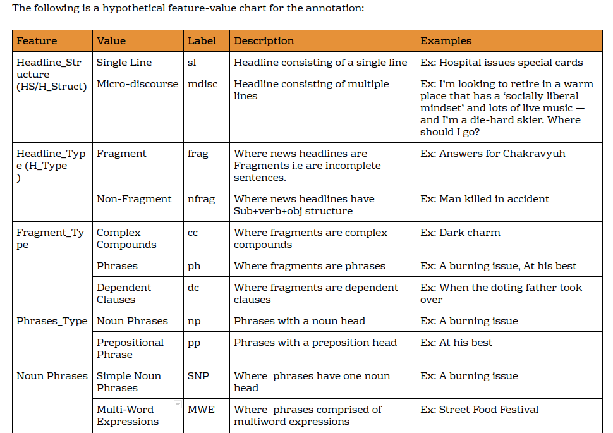
Feature-Value Model Phase II

Slide 45
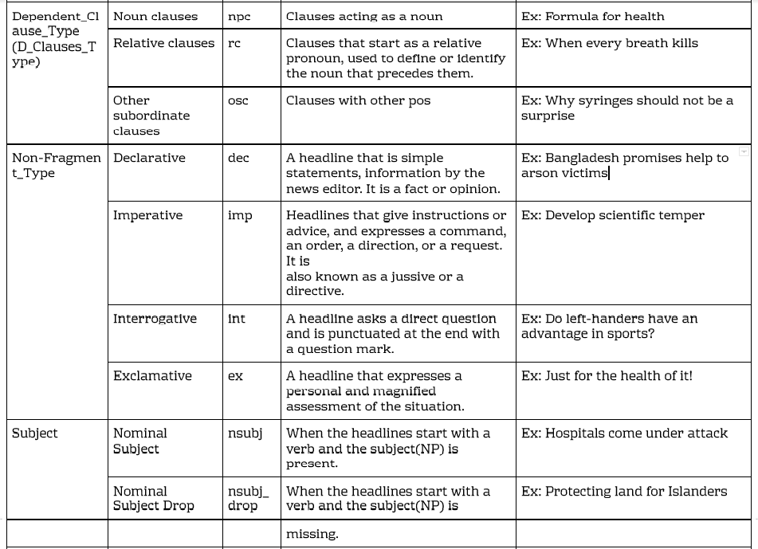

Slide 46
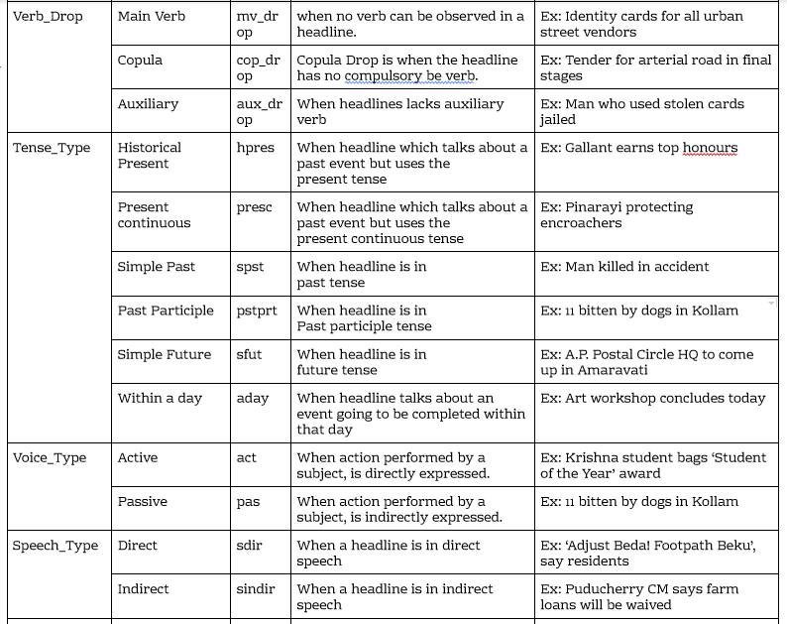

Slide 47
Punctuation_Type (Punct_Type) | Comma | com | If Headline consists of a comma
 | Colon | col | If Headline consists of a colon
 | Semi-colon | scol | If Headline consists of a semi-colon

Slide 48
Annotation: Phase II
Annotators given data to annotate
Covering different headline constructions
Detailed information about categories
same number of headlines covering various differences
The annotators were linguists
Cohen’s kappa: 80.65%
Indicating still some limitations remained

Slide 49
Feature-Value Annotation Model
Pattern:
For fragments:
H_Structure;H_Type; Fragment_Type;Phrase_Type;D_Clauses_Type
For Non-fragments: H_Structure;H_Type;Non-Fragment_Type;subj_drop;V_Drop;Tense_type;Voice_Type;Speech_Type;Question_Type ;Punct_Type
Examples:
Fragment:
Vegetable Dip: sl;frag;ph;cc
Women on top: sl;frag;ph;snp
Non-Fragment:
11 bitten by dog in Kollam: sl;nfrag;dec;nsubj;aux_drop;pstprt;pas;s_indir;0;0
Ryot killed by cow vigilantes, says family: sl;nfrag;dec;nsubj;aux_drop;spst;pas;s_indir;0;com

Slide 50
Comparison
Feature-value Phase I
Flat categorization based on manual annotation
Had only 10 broadly classified categories and no sub-categories
Simplified
Feature-value Phase II
Feature–value hierarchy allowing nested relations
Have 13 Categories and sub-categories
Detailed

Slide 51
Guideline Creation for Canonical Construction of NHs
Guideline creation:
Covering the various structures of NHs found
From linguistic analysis
Condition: If headlines are in present tense
Type 1: Singular verbs
Solution:
Change verb to either present continuous or past construction
Depending on the occurrence of event

Slide 52
Guidelines Contd.
Type 1: Singular verbs
Type 1.a.: Regular verbs:
Art workshop concludes today
Art workshop is concluding today
Type 1.b.: Irregular verbs:
Woman passenger falls to death
A Woman passenger fell to death

Slide 53
Guideline Contd.
Type 2: Plural verbs:
Solution: Change verb to past tense for past events
Type 2.a.: Plural_regular verbs
ICC nod for independent director
ICC noded for independent director
Type 2.b.: Plural_irregular verbs
Hospitals come under attack
Hospitals came under attack

Slide 54
Parallel Corpus
Parallel corpus of 4,000 (approx.) NHs
Grammatically transformed canonical forms
Manually aligned and validated
Enables supervised training and evaluation of parser adaptation
Examples:
Past:
Church reformation celebrated
The church reformation was celebrated
Present:
Rajini app crosses 1 lakh downloads
The Rajini app crossed 1 lakh downloads

Slide 55
Another Look at the Parallel Corpus
On closer inspection, we found:
Converted ‘canonical’ forms were not really canonical
Missing some elements
Not full sentences
In almost all cases
First goal of then
To make them really canonical
As full sentences
Wherever enough context for morphosyntactic interpretation possible
Otherwise
Leave them as they are
So they don’t adversely affect the last and most important part
Of this work

Slide 56
Conversion to Truly Canonical Forms
To avoid delay, tried to use LLMs
Iteratively refined instructions as prompts
Using multiple LLMs: Free versions from browsers
Prompt, input and output limits caused problems
Instructions had to be repeatedly given
Many problems in the process
Ultimately able to convert after several iterations
Fast manual inspection after each batch and every iteration
Took almost as long as manual conversion would have

Slide 57
Further Checking of Alignment of Converted Batches
Limitations of batch-wise conversion and multiple iterations
Ensuring alignment took time and some manual work
Final checking of converted forms
Manual correction in some cases
At the end, truly parallel corpus
Reduced (NH) versions to canonical versions
Used this very good quality resource as the base for further work

Slide 58
Starting with Created Feature-Value Representation
Using manually created feature-value representation
Of register differences
Converted to JSON schema
Further extensive refinement of the schema
Based on the very good quality register-parallel corpus
Used the much better Stanza parser
Does both constituency and dependency parsing
Both kinds of parses created for the complete corpus
Reduced versions and canonical versions

Slide 59
Feature Extraction
Using the parsed (constituency and dependency)
Features extracted by a Python project created for this purpose
Quantitative differences in terms of refined feature-value schema
Tabular data about the register differences
Most importantly
Instead of thinking in terms of parser ‘errors’
We focused on the register differences
Reason: The ‘errors’ are mostly register differences
There may be genuine errors too, obviously
But it is not fruitful to think in terms of these

Slide 60
Further Refinement of the Schema
Using the results obtained from the previous step
Kinds of missing differences extracted
Used to further refine the schema
Several iterations
But much faster this time using custom Python code

Slide 61
Visualization of Results
Finally, using the refined schema and extracted quantitative differences
Number of visualizations created
Purpose being to get analytical insights about the register differences
Could validate/contradict some/all of theoretical observations
In past work and in this work

Slide 62
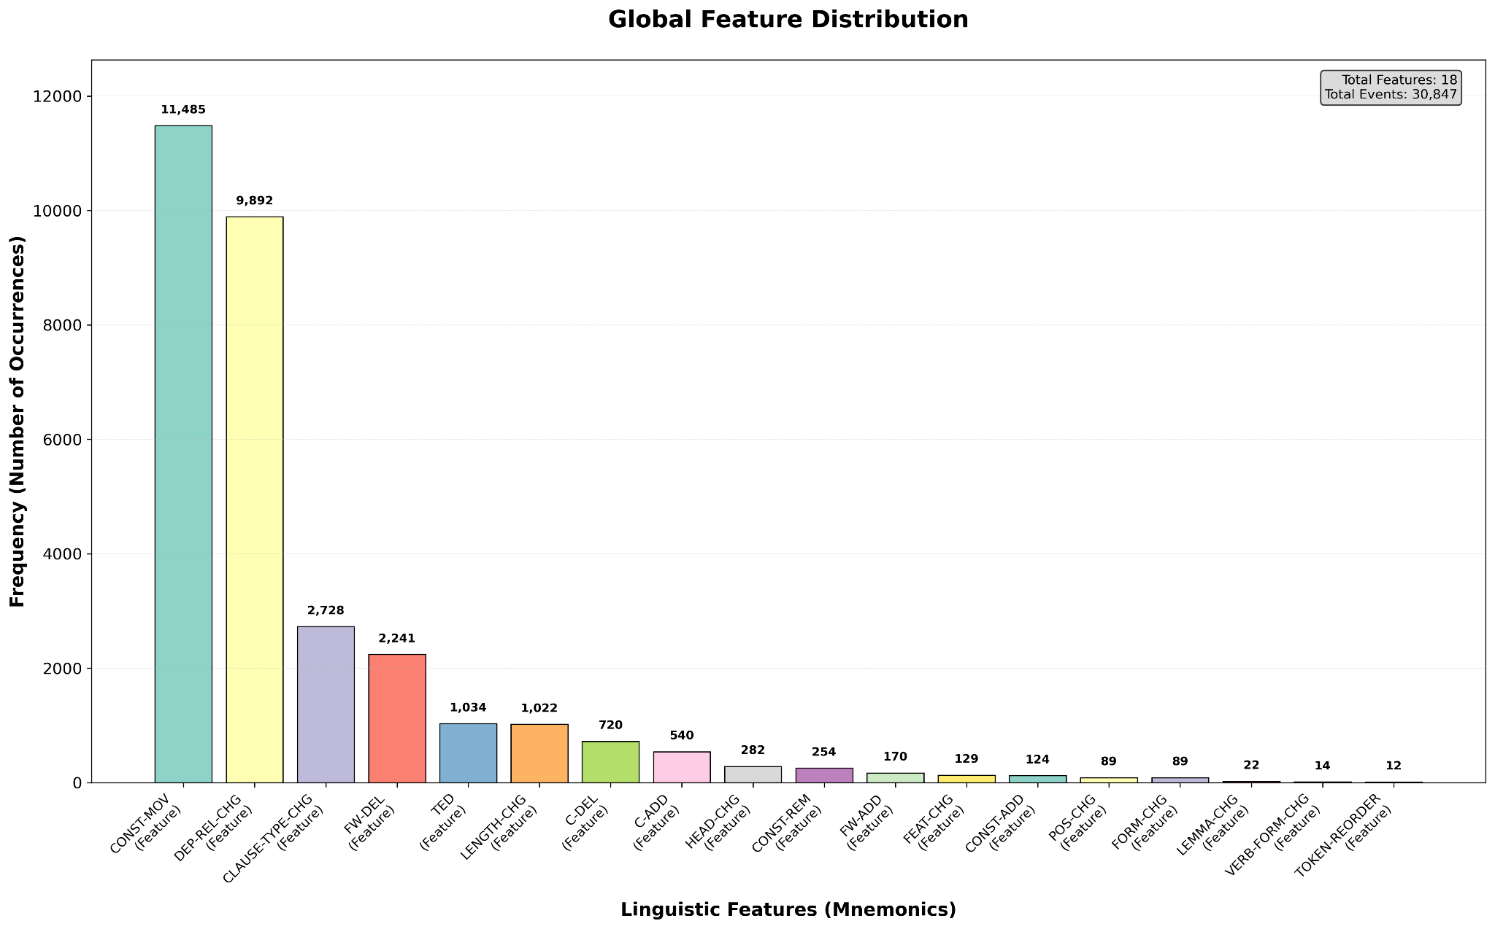
Global Feature Distribution

Slide 63
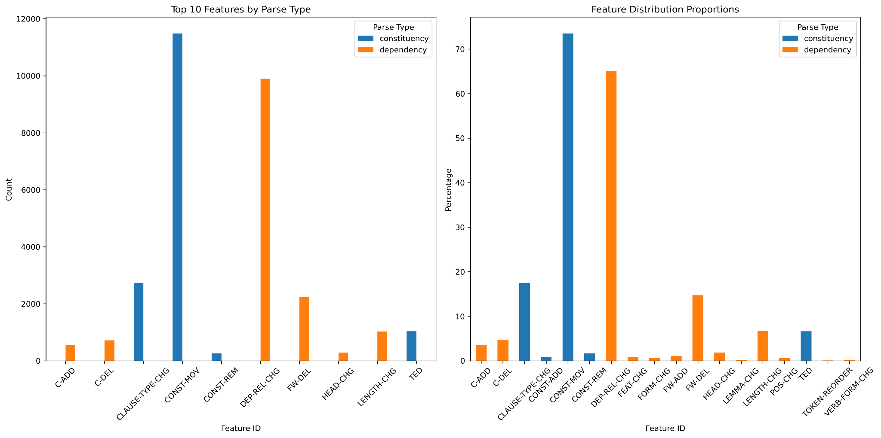
Parse-Type Comparison: All Feature-Value Pairs

Slide 64
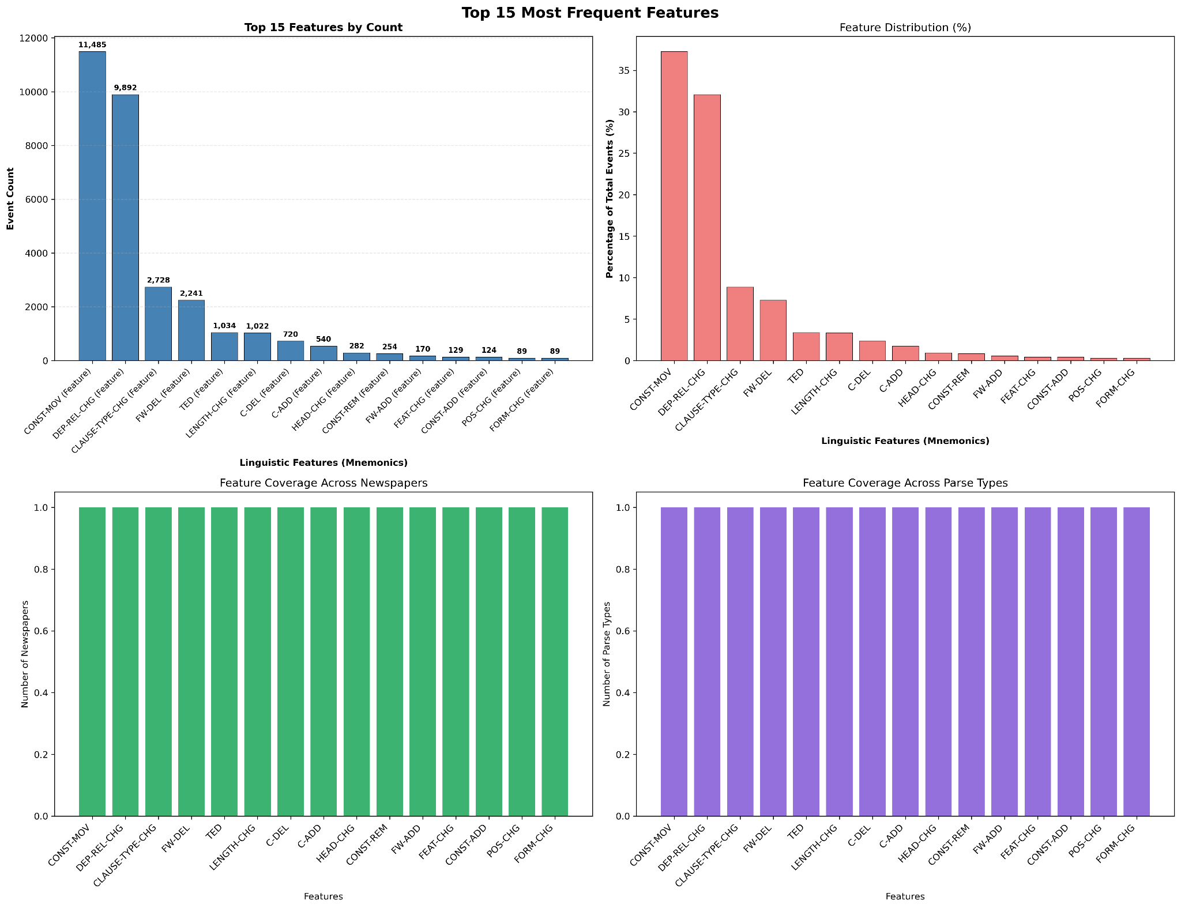
Top Feature-Value Transformations: All Pairs

Slide 65
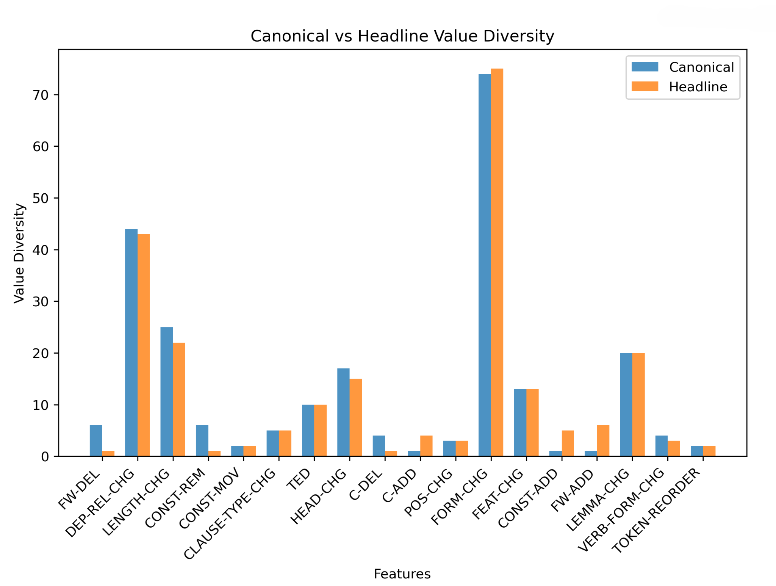
Canonical vs. Reduced: Diversity

Slide 66
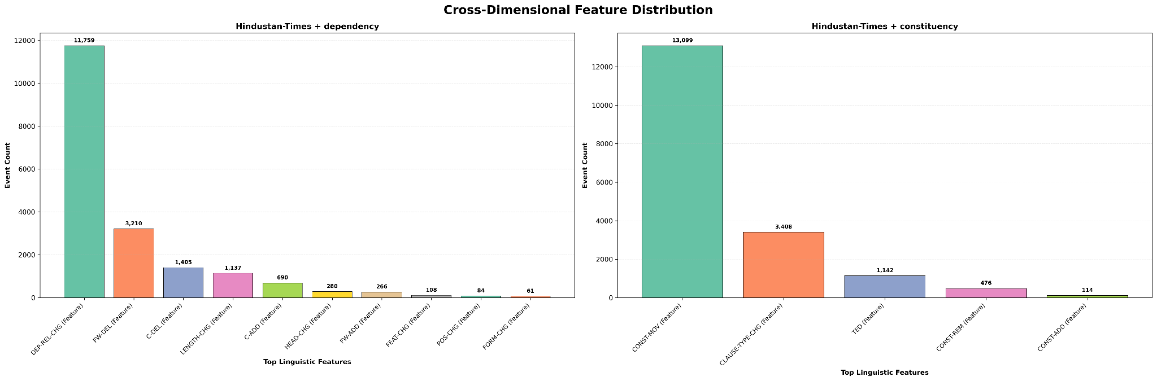
Cross-Dimensional Feature-Value Distribution: HT

Slide 67
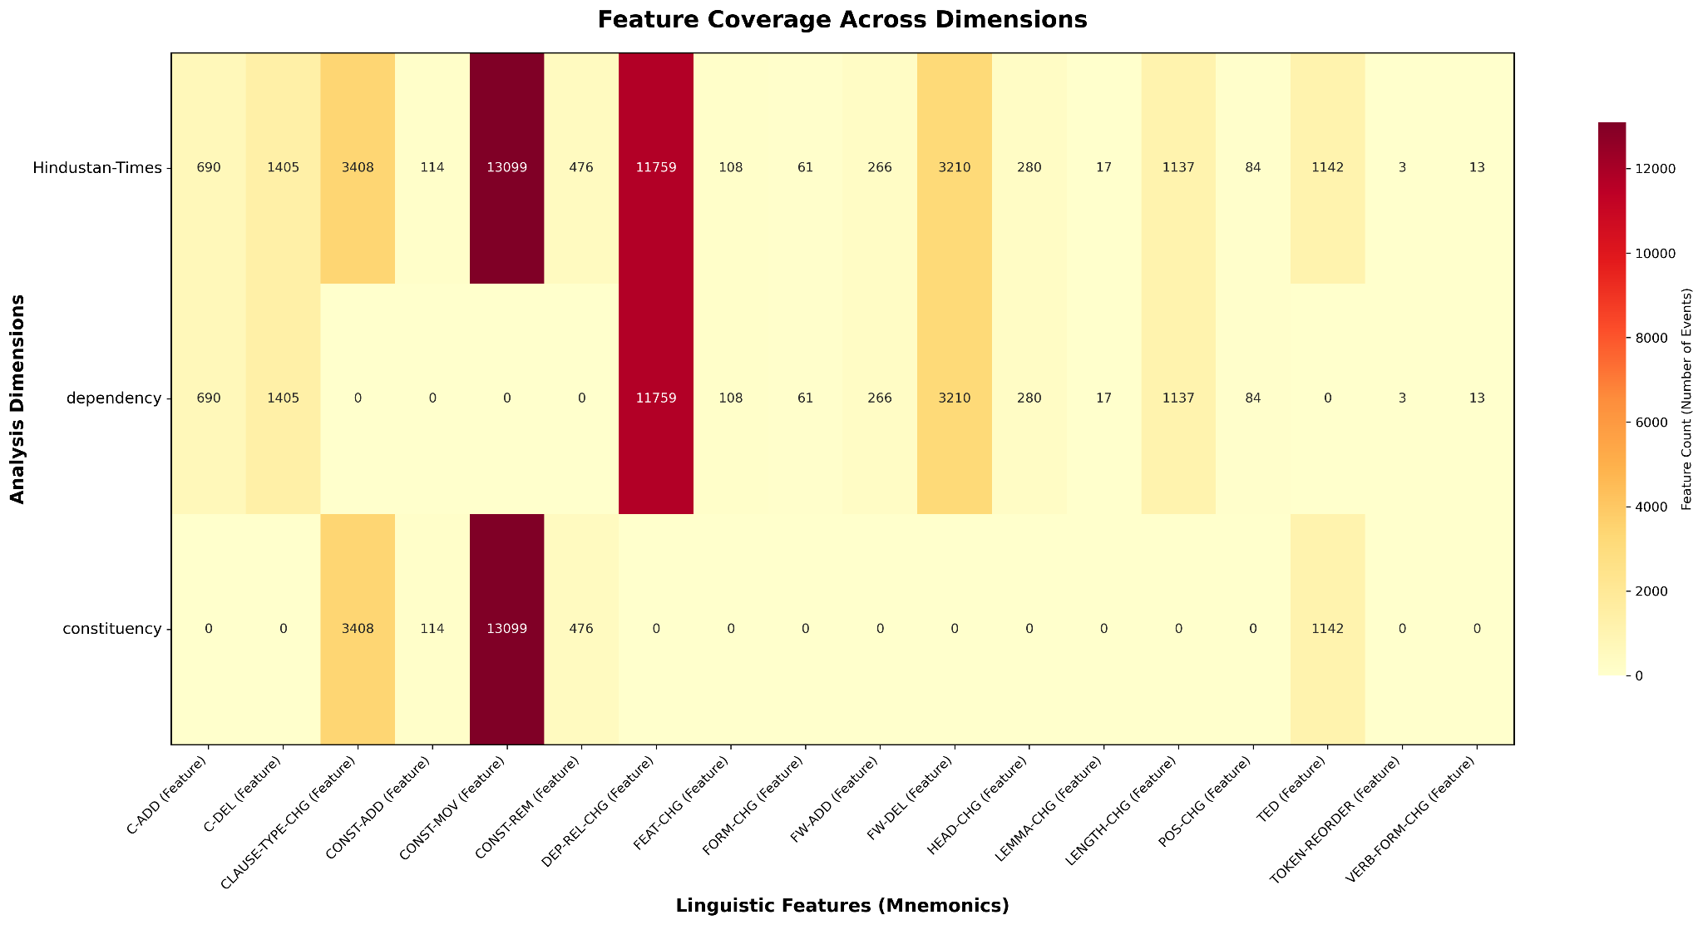
Feature-Value Pair Coverage Across Dimensions: HT

Slide 68
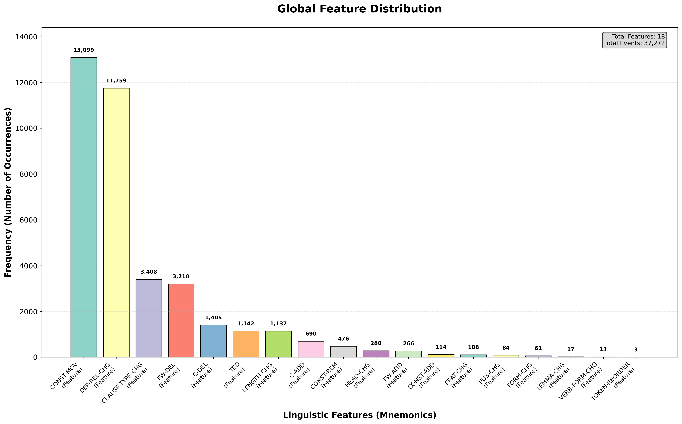
Global F-V Distribution: HT

Slide 69
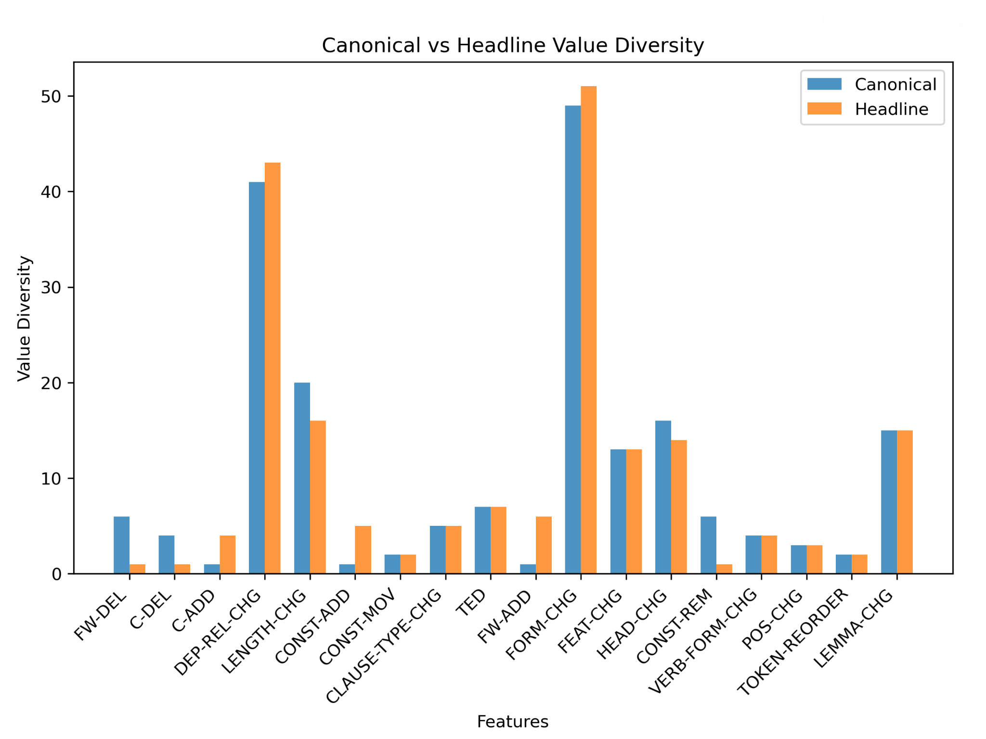
Canonical-Reduced Value Diversity: HT

Slide 70
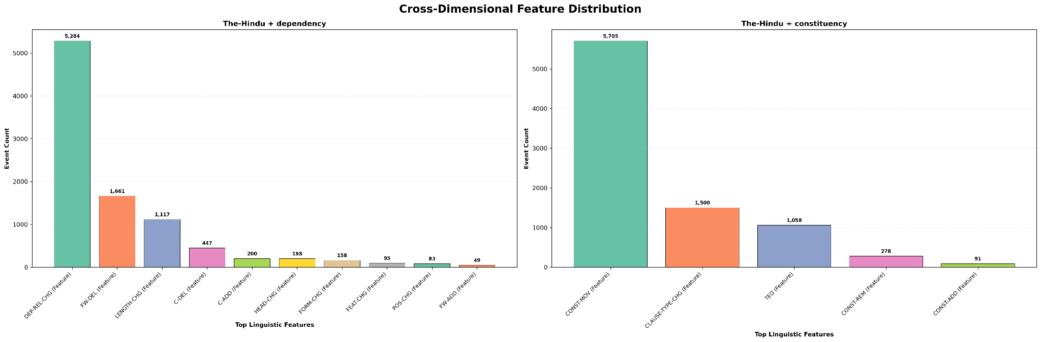
Cross-Dimensional Feature-Value Distribution: TH

Slide 71
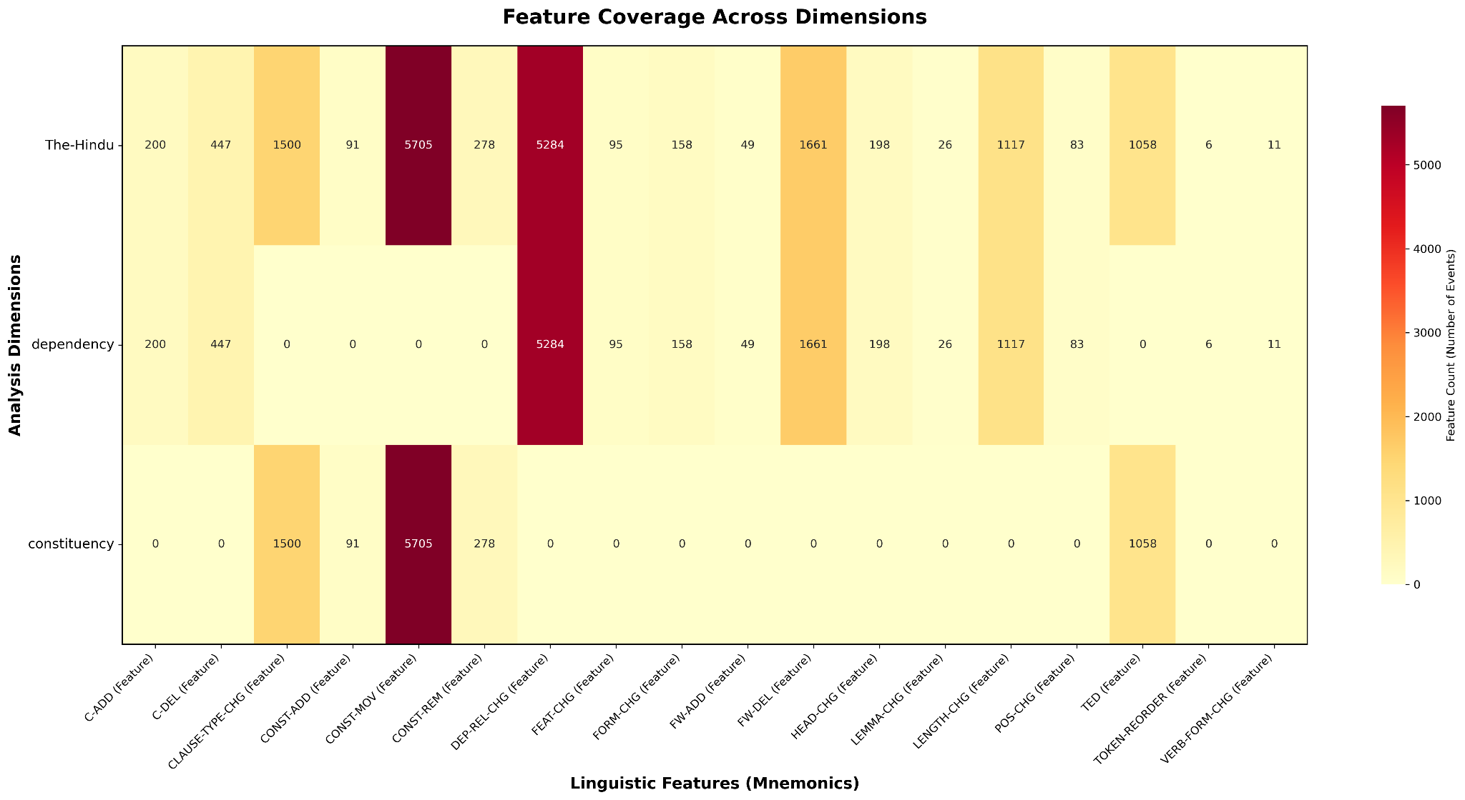
Feature-Value Pair Coverage Across Dimensions: TH

Slide 72
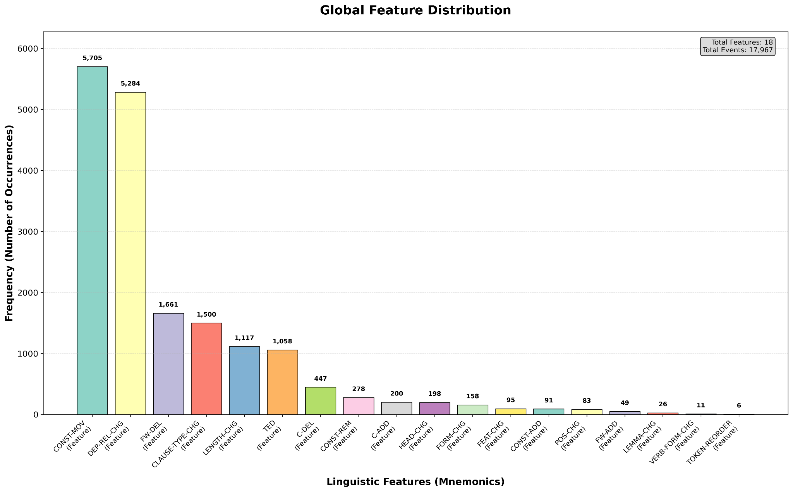
Global F-V Distribution: TH

Slide 73
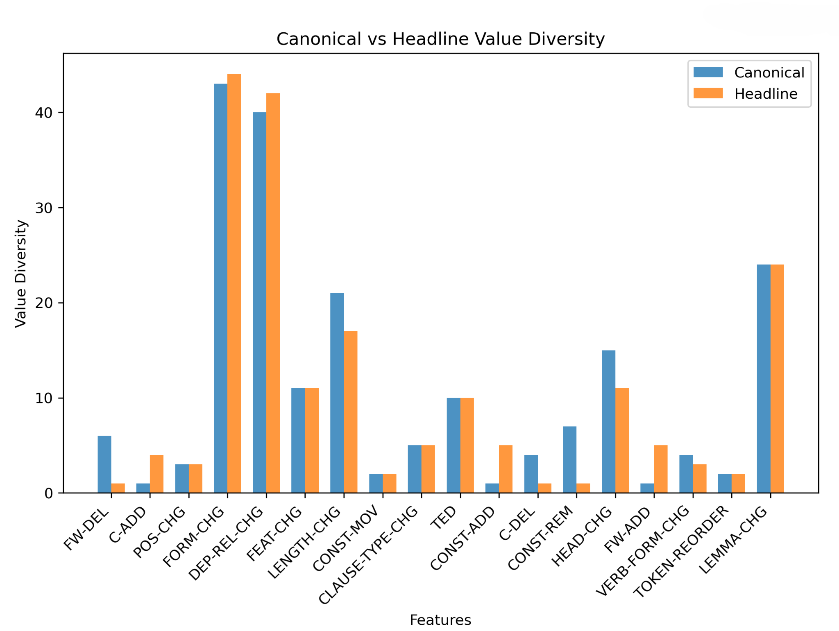
Canonical-Reduced Value Diversity: TH

Slide 74
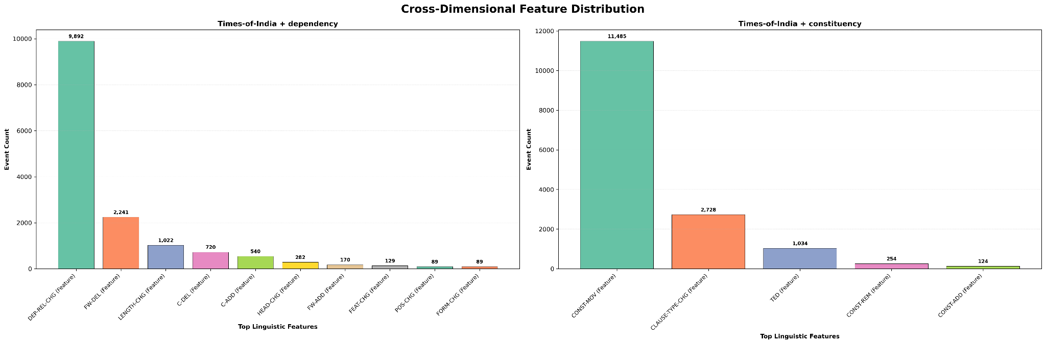
Cross-Dimensional Feature-Value Distribution: TOI

Slide 75
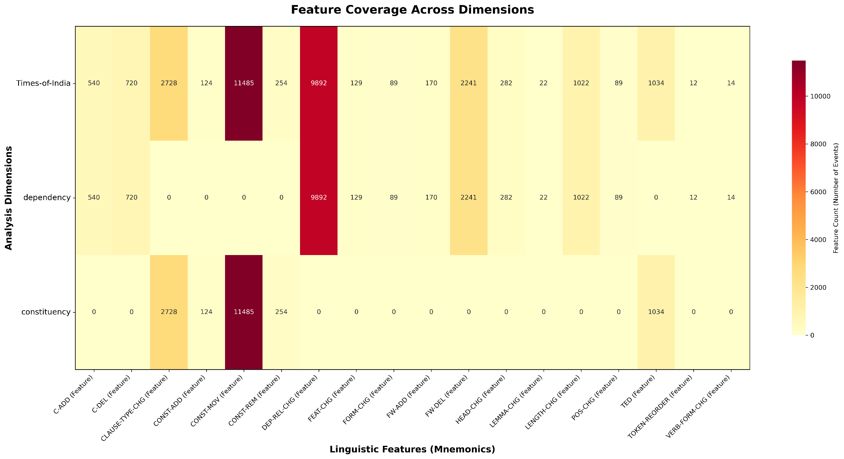
Feature-Value Pair Coverage Across Dimensions: TOI

Slide 76
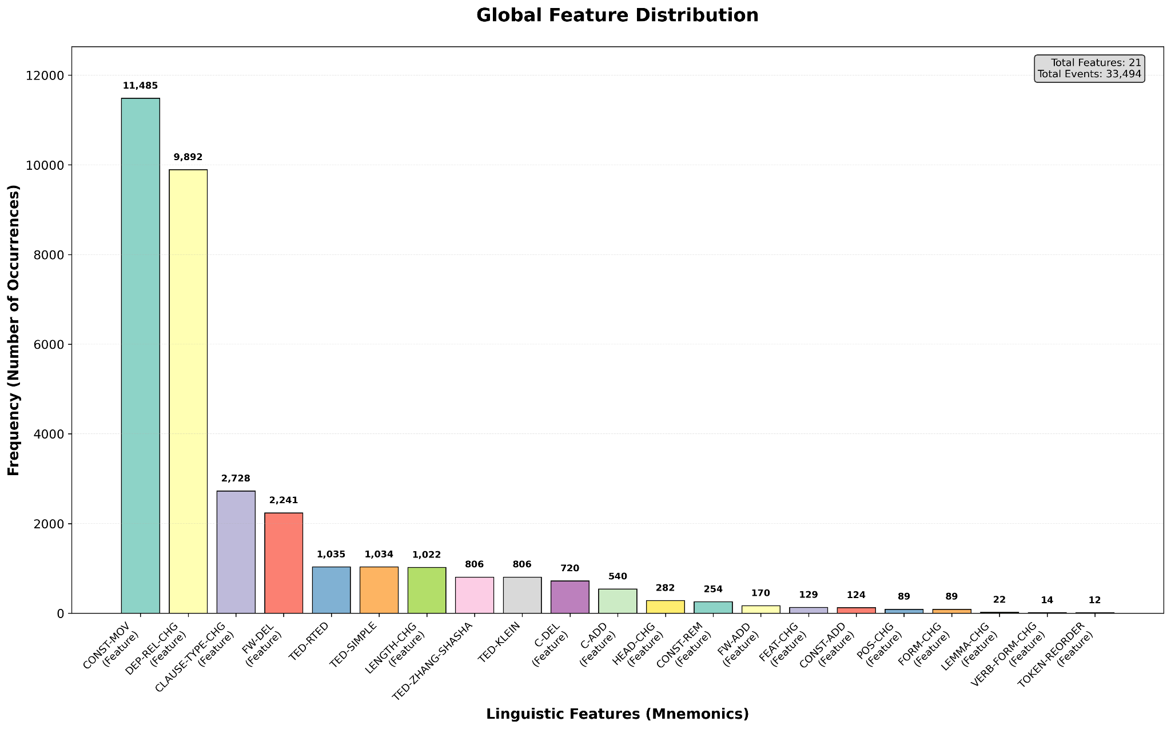
Top Global F-V Distribution: TOI

Slide 77

Canonical-Reduced Value Diversity: TOI

Slide 78
Observations from the Results: Refined Schema
As can be seen from the previous visualizations
Global (all newspaper data combined)
And individual newspapers
Results are almost the same in terms of visualizations
This means the register differences are
Systematic, irrespective of the newspaper
The same kinds of F-V differences appear
And in the same distributions

Slide 79
Conclusion
The results validate the past theoretical studies
About register differences
Same kinds of differences observed from quantitative comparison
And analysis
Visualizations demonstrate this very clearly
The experimental design can be used for other registers
Results likely to be generalizable
But need more detailed checking in future work

Slide 80
Thank You!

